Slide 1
Principles of Distributed Database Systems
M. Tamer Özsu
Patrick Valduriez

Slide 2
Outline
Distributed and Parallel Database Design
Fragmentation
Data distribution
Adaptive approaches

Slide 3
Vertical Fragmentation
Has been studied within the centralized context
design methodology
physical clustering
More difficult than horizontal, because more alternatives exist.
Two approaches :
grouping
attributes to fragments
splitting
relation to fragments

Slide 4
Vertical Fragmentation
Overlapping fragments
grouping
Non-overlapping fragments
splitting
We do not consider the replicated key attributes to be overlapping.
Advantage:
Easier to enforce functional dependencies
(for integrity checking etc.)

Slide 5
VF – Information Requirements
Application Information
Attribute affinities
a measure that indicates how closely related the attributes are
This is obtained from more primitive usage data
Attribute usage values
Given a set of queries Q = {q₁, q₂,…, q_{q}} that will run on the relation R[A₁, A₂,…, A_{n}],
use(q_{i},*) can be defined accordingly
⎧
1 if attribute A_{j} is referenced by query q_{i}
use(q_{i},A_{j}) =
⎨
⎩
0 otherwise

Slide 6
VF – Definition of use(q_{i},A_{j})
Consider the following 4 queries for relation PROJ
q₁: SELECT BUDGET q₂: SELECT PNAME, BUDGET
FROM PROJ FROM PROJ
WHERE PNO=Value
q₃: SELECT PNAME q₄: SELECT SUM(BUDGET)
FROM PROJ FROM PROJ
WHERE LOC=Value WHERE LOC=Value
Let A₁= PNO, A₂= PNAME, A₃= BUDGET, A₄= LOC
A₁
A₂
A₃
A₄
q₁
1
0
1
0
q₂
0
1
1
0
q₃
0
1
0
1
q₄
0
0
1
1

Slide 7
VF – Affinity Measure aff(A_{i},A_{j})
The attribute affinity measure between two attributes A_{i} and A_{j} of a relation R[A₁, A₂, …, A_{n}] with respect to the set of applications Q = (q₁, q₂, …, q_{q}) is defined as follows :
∑
aff (A_{i}, A_{j}) =
(query access)
all queries that access A_{i} and A_{j}
aff ( Ai, Aj ) = ∑ ∑ref_{s} (q_{k} ) ⋅ acc_{s} (q_{k} ) ∀k , use(q_{k}, A_{i} )=1 ∧ use(q_{k}, A_{j} )=1 ∀s

Slide 8
Attribute Affinity Matrix
aff ( Ai, Aj ) = ∑ ∑ref_{s} (q_{k} ) ⋅ acc_{s} (q_{k} ) ∀k , use(q_{k} , A_{i} )=1 ∧ use(q_{k} , A_{j} )=1 ∀s
For each query q_{k} that uses both A_{i} and A_{j}
Popularity of such A_{i}-A_{j} pair at all site
ref_{s} (q_{k}): Number of accesses
to attributes (A_{i},A_{j})
for each execution
A₁ A₂ A₃ A₄
A₁ A₂ A₃ A₄
aff ( A2, A3)
of q at site s
k
acc (q ): Application access
s k
frequency of q_{k} at site s.
Attribute Affinity Matrix

Slide 9














Attribute Affinity Measure
aff ( Ai, Aj ) = ∑ ∑ref_{s} (q_{k} ) ⋅ acc_{s} (q_{k} ) ∀k , use(q_{k} , A_{i} )=1 ∧ use(q_{k} , A_{j} )=1 ∀s
For each query q_{k} that uses both A_{i} and A_{j}
Popularity of such A_{i}-A_{j} pair at all site
Relation R
Site m
Site n
q_{k}
A_{i}
q_{i}
q_{i}
q_{i}
A_{k}
A_{j}
ref_{s} (q_{k} )
Site s
q_{k}
acc (q )
ref_{s}(q_{k}) : Number of accesses to attributes (A_{i},A_{j}) for each execution of q_{k} at site s
q_{i}
s k
acc_{s} (q_{k}) : Application access
frequency of q_{k} at site s.

Slide 10
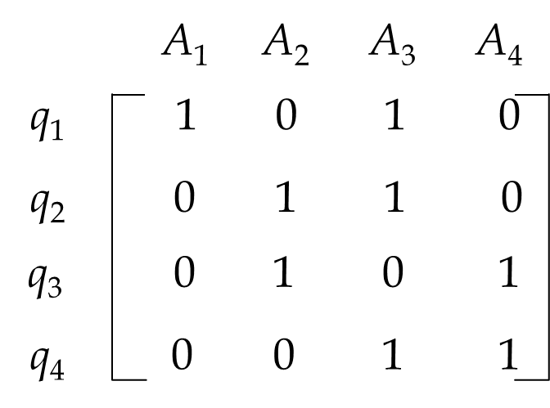
VF – Calculation of aff(A_{i}, A_{j})
Assume each query in the previous example accesses the attributes once during each execution.
Then (assume all = 1)
Also assume the access frequencies
Usage:
aff(A₁, A₃) = 1*15 + 1*20 + 1*10
= 45
and the attribute affinity matrix AA is
ref_{s} (q_{k} )
S
S
S
acc (q )
1
2
3
s k
q
15
20
10
1
q
2
5
0
0
use(q_{i},A_{j})
q
25
25
25
3
q
3
0
0
4
∑
∑
A
A
A
A
aff (A_{i}, A_{j}) =
ref_{s} (q_{k} )
* acc_{s} (q_{k} )
1
2
3
4
A
45
0
45
0
1
A
0
80
5
75
2
A
3
45
5
53
3
A
0
75
3
78
4

Slide 11
VF – Calculation of aff(A_{i}, A_{j})
∑
∑
aff (A_{i}, A_{j}) =
ref_{s} (q_{k} )
* acc_{s} (q_{k} )
acc (q )
- aff(A₁, A₁) = 1*15 + 1*20 + 1*10 = 45,
- aff(A₁, A₂) = 0,
- aff(A₁, A₃) = 1*15 + 1*20 + 1*10 = 45
- aff(A₁, A₄) = 0
- aff(A₂, A₁) = aff(A₁, A₂) = 0,
- aff(A₂, A₂) = 1*5 + 1*0 + 1*0 +
1*25 + 1*25 + 1*25 = 80
- aff(A₂, A₃) = 1*5 + 1*0 + 1*0 = 5
- aff(A₂, A₄) = 1*25 + 1*25 + 1*25 = 75
- aff(A₃, A₁) = aff(A₁, A₃) = 45,
- aff(A₃, A₂) = aff(A₂, A₃) = 5
- aff(A₃, A₃) = 1*15 + 1*20 + 1*10 +
1*5 + 1*0 + 1*0 +
1*3 + 1*0 + 1*0 = 53
- aff(A₃, A₄) = 1*3 + 1*0 + 1*0 = 3
- aff(A₄, A₁) = aff(A₁, A₄) = 0,
- aff(A₄, A₂) = aff(A₂, A₄) = 75
- aff(A₄, A₃) = aff(A₃, A₄) = 3
- aff(A₄, A₄) = 1*25 + 1*25 + 1*25 +
1*3 + 1*0 + 1*0 = 78
s k
S
S
S
1
2
3
q
15
20
10
1
q
2
5
0
0
q
25
25
25
3
A
A
A
A
q
3
0
0
1
2
3
4
4
A
45
0
45
0
1
use(q_{i},A_{j})
A
0
80
5
75
2
A
3
45
5
53
3
A
0
75
3
78
4

Slide 12
Attribute Affinity Matrix Example
 |  | A₁ | A₂ | A₃ | A₄ |  | A₁ | A₂ | A₃ | A₄
q₁ |  | 1 | 0 | 1 | 0 | A₁ | 45 | 0 | 45 | 0
q₂ |  | 0 | 1 | 1 | 0 | A₂ | 0 | 80 | 5 | 75
q₃ |  | 0 | 1 | 0 | 1 | A₃ | 45 | 5 | 53 | 3
q₄ |  | 0 | 0 | 1 | 1 | A₄ | 0 | 75 | 3 | 78
Attribute Usage Matrix
Attribute Affinity Matrix (AA)
Next Step -
Determine clustered affinity (CA) matrix

Slide 13
VF – Clustering Algorithm
Take the attribute affinity matrix AA and reorganize the attribute orders to form clusters where the attributes in each cluster demonstrate high affinity to one another.
Bond Energy Algorithm (BEA) has been used for clustering of entities. BEA finds an ordering of entities (in our case attributes) such that the global affinity measure (AM) is maximized.
AM =
∑
∑
(affinity of A_{i} and A_{j} with their neighbors)
i
j

Slide 14
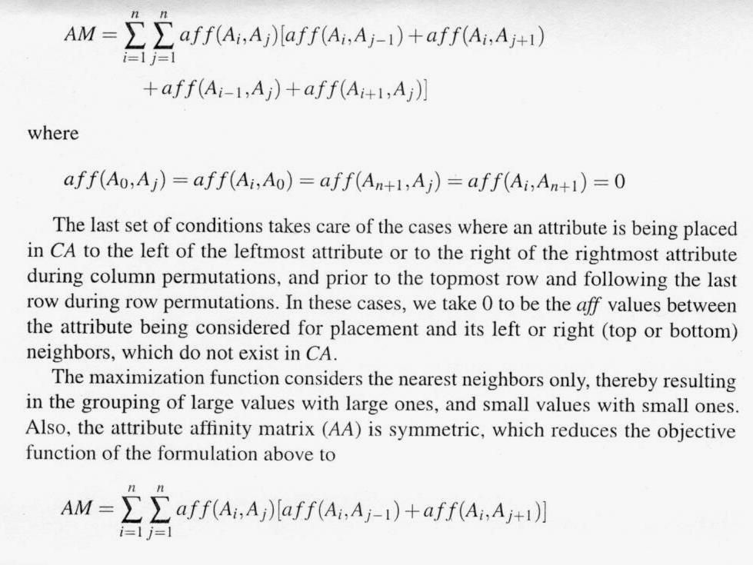
AM (Global Affinity Measure)
2

Slide 15
AM ( Global affinity measure)
2AM ^{n}_{i=1} =
∑^{n}_{i=1} ∑^{n}_{j=1} aff(A_{i}, A_{j}) [aff(A_{i}, A_{j-1}) + aff(A_{i}, A_{j+1}) + aff(A_{i-1}, A_{j}) + aff(A_{i+1}, A_{j})]
where aff(A_{i}, A_{j}) = aff(A_{j}, A_{i}), and
aff (A_{0,} A_{j}) = aff(A_{i}, A₀) = aff(A_{n+1}, A_{j}) = aff( A_{i,} A_{n+1}) = 0
2AM ²_{i=1} =
∑²_{i=1} ∑²_{j=1} aff(A_{i}, A_{j}) [aff(A_{i}, A_{j-1}) + aff(A_{i}, A_{j+1}) + aff(A_{i-1}, A_{j}) + aff(A_{i+1}, A_{j})]
= aff(A_{1,} A₁) [aff(A_{1,} A₀) + aff(A_{1,} A₂) + aff(A_{0,} A₁) + aff(A_{2,} A₁)]
+ aff(A_{1,} A₂) [aff(A_{1,} A₁) + aff(A_{1,} A₃) + aff(A_{0,} A₂) + aff(A_{2,} A₂)]
+ aff(A_{2,} A₁) [aff(A_{2,} A₀) + aff(A_{2,} A₂) + aff(A_{1,} A₁) + aff(A_{3,} A₁)]
+ aff(A_{2,} A₂) [aff(A_{2,} A₁) + aff(A_{2,} A₃) + aff(A_{1,} A₂) + aff(A_{3,} A₂)]

Slide 16
AM ( Global affinity measure)
2AM ²_{i=1} =
∑²_{i=1} ∑²_{j=1} aff(A_{i}, A_{j}) [aff(A_{i}, A_{j-1}) + aff(A_{i}, A_{j+1}) + aff(A_{i-1}, A_{j}) + aff(A_{i+1}, A_{j})]
= aff(A_{1,} A₁) [aff(A_{1,} A₀) + aff(A_{1,} A₂) + aff(A_{0,} A₁) + aff(A_{2,} A₁)]
+ aff(A_{1,} A₂) [aff(A_{1,} A₁) + aff(A_{1,} A₃) + aff(A_{0,} A₂) + aff(A_{2,} A₂)]
+ aff(A_{2,} A₁) [aff(A_{2,} A₀) + aff(A_{2,} A₂) + aff(A_{1,} A₁) + aff(A_{3,} A₁)]
+ aff(A_{2,} A₂) [aff(A_{2,} A₁) + aff(A_{2,} A₃) + aff(A_{1,} A₂) + aff(A_{3,} A₂)]
where aff(A_{1,} A₀) = aff(A_{0,} A₁) = aff(A_{1,} A₃) = aff(A_{0,} A₂) = aff(A_{2,} A₀)
= aff(A_{3,} A₁) = aff(A_{2,} A₃) = aff(A_{3,} A₂) = 0

Slide 17
AM ( Global affinity measure)
2AM ²_{i=1} =
∑²_{i=1} ∑²_{j=1} aff(A_{i}, A_{j}) [aff(A_{i}, A_{j-1}) + aff(A_{i}, A_{j+1}) + aff(A_{i-1}, A_{j}) + aff(A_{i+1}, A_{j})]
= aff(A_{1,} A₁) [aff(A_{1,} A₂) + aff(A_{2,} A₁)]
+ aff(A_{1,} A₂) [aff(A_{1,} A₁) + aff(A_{2,} A₂)]
+ aff(A_{2,} A₁) [aff(A_{2,} A₂) + aff(A_{1,} A₁)]
+ aff(A_{2,} A₂) [aff(A_{2,} A₁) + aff(A_{1,} A₂)]
= aff(A_{1,} A₁) [aff(A_{1,} A₂) + aff(A_{1,} A₂)]
+ aff(A_{1,} A₂) [aff(A_{1,} A₁) + aff(A_{2,} A₂)]
+ aff(A_{2,} A₁) [aff(A_{1,} A₁) + aff(A_{2,} A₂)]
+ aff(A_{2,} A₂) [aff(A_{2,} A₁) + aff(A_{2,} A₁)]

Slide 18
AM ( Global affinity measure)
2AM ²_{i=1} =
∑²_{i=1} ∑²_{j=1} aff(A_{i}, A_{j}) [aff(A_{i}, A_{j-1}) + aff(A_{i}, A_{j+1}) + aff(A_{i-1}, A_{j}) + aff(A_{i+1}, A_{j})]
= aff(A_{1,} A₁) [aff(A_{1,} A₂) + aff(A_{1,} A₂)]
+ aff(A_{1,} A₂) [aff(A_{1,} A₁) + aff(A_{2,} A₂)]
+ aff(A_{2,} A₁) [aff(A_{1,} A₁) + aff(A_{2,} A₂)]
+ aff(A_{2,} A₂) [aff(A_{2,} A₁) + aff(A_{2,} A₁)]
= aff(A_{1,} A₁) aff(A_{1,} A₂) + aff(A_{1,} A₁) aff(A_{1,} A₂)
+ aff(A_{1,} A₂) aff(A_{1,} A₁) + aff(A_{1,} A₂) aff(A_{2,} A₂)
+ aff(A_{2,} A₁) aff(A_{1,} A₁) + aff(A_{2,} A₁) aff(A_{2,} A₂)
+ aff(A_{2,} A₂) aff(A_{2,} A₁) + aff(A_{2,} A₂) aff(A_{2,} A₁)

Slide 19
AM ( Global affinity measure)
2AM ²_{i=1} =
∑²_{i=1} ∑²_{j=1} aff(A_{i}, A_{j}) [aff(A_{i}, A_{j-1}) + aff(A_{i}, A_{j+1}) + aff(A_{i-1}, A_{j}) + aff(A_{i+1}, A_{j})]
= aff(A_{1,} A₁) aff(A_{1,} A₂) + aff(A_{1,} A₁) aff(A_{1,} A₂)
+ aff(A_{1,} A₂) aff(A_{1,} A₁) + aff(A_{1,} A₂) aff(A_{2,} A₂)
+ aff(A_{2,} A₁) aff(A_{1,} A₁) + aff(A_{2,} A₁) aff(A_{2,} A₂)
+ aff(A_{2,} A₂) aff(A_{2,} A₁) + aff(A_{2,} A₂) aff(A_{2,} A₁)
= 2 aff(A_{1,} A₁) aff(A_{1,} A₂)
+ aff(A_{1,} A₂) aff(A_{1,} A₁) + aff(A_{2,} A₁) aff(A_{2,} A₂)
+ aff(A_{1,} A₂) aff(A_{1,} A₁) + aff(A_{2,} A₁) aff(A_{2,} A₂)
+ 2 aff(A_{2,} A₂) aff(A_{2,} A₁)

Slide 20
AM ( Global affinity measure)
2AM ²_{i=1} =
∑²_{i=1} ∑²_{j=1} aff(A_{i}, A_{j}) [aff(A_{i}, A_{j-1}) + aff(A_{i}, A_{j+1}) + aff(A_{i-1}, A_{j}) + aff(A_{i+1}, A_{j})]
= 2 aff(A_{1,} A₁) aff(A_{1,} A₂)
+ aff(A_{1,} A₂) aff(A_{1,} A₁) + aff(A_{2,} A₁) aff(A_{2,} A₂)
+ aff(A_{1,} A₂) aff(A_{1,} A₁) + aff(A_{2,} A₁) aff(A_{2,} A₂)
+ 2 aff(A_{2,} A₂) aff(A_{2,} A₁)
= 2 aff(A_{1,} A₁) aff(A_{1,} A₂)
+ 2 aff(A_{1,} A₂) aff(A_{1,} A₁)
+ 2 aff(A_{2,} A₁) aff(A_{2,} A₂)
+ 2 aff(A_{2,} A₂) aff(A_{2,} A₁)

Slide 21
AM ( Global affinity measure)
2AM ²_{i=1} =
∑²_{i=1} ∑²_{j=1} aff(A_{i}, A_{j}) [aff(A_{i}, A_{j-1}) + aff(A_{i}, A_{j+1}) + aff(A_{i-1}, A_{j}) + aff(A_{i+1}, A_{j})]
= 2 aff(A_{1,} A₁) aff(A_{1,} A₂)
+ 2 aff(A_{1,} A₂) aff(A_{1,} A₁)
+ 2 aff(A_{2,} A₁) aff(A_{2,} A₂)
+ 2 aff(A_{2,} A₂) aff(A_{2,} A₁)
AM ²_{i=1} = aff(A_{1,} A₁) aff(A_{1,} A₂)
+ aff(A_{1,} A₂) aff(A_{1,} A₁)
+ aff(A_{2,} A₁) aff(A_{2,} A₂)
+ aff(A_{2,} A₂) aff(A_{2,} A₁)

Slide 22
AM ( Global affinity measure)
AM ^{n}_{i=1} = ∑^{n}_{i=1} ∑^{n}_{j=1} aff(A_{i,} A_{j}) [aff(A_{i,} A_{j-1}) + aff(A_{i,} A_{j+1})]
AM ²_{i=1} = aff(A_{1,} A₁) [aff(A_{1,} A₀) + aff(A_{1,} A₂)]
+ aff(A_{1,} A₂) [aff(A_{1,} A₁) + aff(A_{1,} A₃)]
+ aff(A_{2,} A₁) [aff(A_{2,} A₀) + aff(A_{2,} A₂)]
+ aff(A_{2,} A₂) [aff(A_{2,} A₁) + aff(A_{2,} A₃)]
AM ²_{i=1} = aff(A_{1,} A₁) [aff(A_{1,} A₀) + aff(A_{1,} A₂)]
+ aff(A_{1,} A₂) [aff(A_{1,} A₁) + aff(A_{1,} A₃)]
+ aff(A_{2,} A₁) [aff(A_{2,} A₀) + aff(A_{2,} A₂)]
+ aff(A_{2,} A₂) [aff(A_{2,} A₁) + aff(A_{2,} A₃)]
where aff(A_{1,} A₀) = aff(A_{1,} A₃) = aff(A_{2,} A₀) = aff(A_{2,} A₃) = 0

Slide 23
AM ( Global affinity measure)
AM ²_{i=1} = aff(A_{1,} A₁) [aff(A_{1,} A₀) + aff(A_{1,} A₂)]
+ aff(A_{1,} A₂) [aff(A_{1,} A₁) + aff(A_{1,} A₃)]
+ aff(A_{2,} A₁) [aff(A_{2,} A₀) + aff(A_{2,} A₂)]
+ aff(A_{2,} A₂) [aff(A_{2,} A₁) + aff(A_{2,} A₃)]
where aff(A_{1,} A₀) = aff(A_{1,} A₃) = aff(A_{2,} A₀) = aff(A_{2,} A₃) = 0
AM ²_{i=1} = aff(A_{1,} A₁) aff(A_{1,} A₂)
+ aff(A_{1,} A₂) aff(A_{1,} A₁)
+ aff(A_{2,} A₁) aff(A_{2,} A₂)
+ aff(A_{2,} A₂) aff(A_{2,} A₁)

Slide 24
AM (Global Affinity Measure)
2

Slide 25
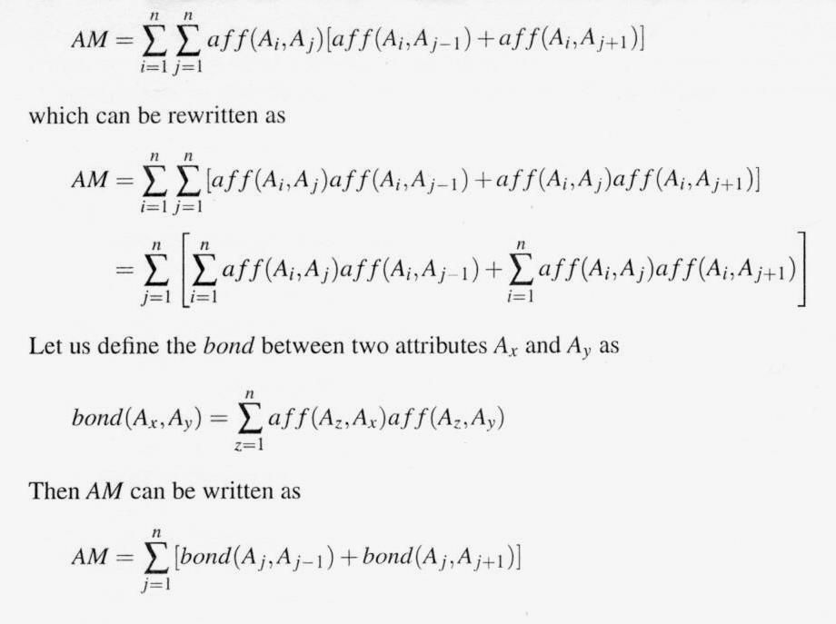
AM (Global Affinity Measure)

Slide 26
AM (Global Affinity Measure)
AM ^{n}_{j=1} = ∑^{n}_{j=1} [bond(A_{j,} A_{j-1}) + bond(A_{j,} A_{j+1})]
AM_old ^{n}_{j=1} = bond(A₁, A₀) + bond(A₁, A₂) + bond(A₂, A₁) + bond(A₂, A₃)
+ bond(A₃, A₂) + bond(A₃, A₄) + … + bond(A_{i}, A_{j})
+ bond(A_{j}, A_{i}) + … + bond(A_{n-1}, A_{n-2}) + bond(A_{n-1}, A_{n})
+ bond(A_{n}, A_{n-1}) + bond(A_{n}, A_{n+1})
AM_new ^{n}_{j=1} = bond(A₁, A₀) + bond(A₁, A₂) + bond(A₂, A₁) + bond(A₂, A₃)
+ bond(A₃, A₂) + bond(A₃, A₄) + … + bond(A_{i}, A_{k})
+ bond(A_{k}, A_{i}) + bond(A_{k}, A_{j}) + bond(A_{j}, A_{k})
+ … + bond(A_{n-1}, A_{n-2}) + bond(A_{n-1}, A_{n}) + bond(A_{n}, A_{n-1})
+ bond(A_{n}, A_{n+1})
(A_{k}, is added
between A_{i}
and A_{j})

Slide 27
AM (Global Affinity Measure)
cont(A_{i}, A_{k}, A_{j}) = AM_new ^{n}_{m=1} - AM_old ^{n}_{m=1}
= [bond(A₁, A₀) + bond(A₁, A₂) + bond(A₂, A₁) + bond(A₂, A₃) + bond(A₃, A₂) + bond(A₃, A₄) + … + bond(A_{i}, A_{k}) + bond(A_{k}, A_{i}) + bond(A_{k}, A_{j}) + bond(A_{j}, A_{k}) + … + bond(A_{n-1}, A_{n-2}) + bond(A_{n-1}, A_{n}) + bond(A_{n}, A_{n-1}) + bond(A_{n}, A_{n+1})]
– [bond(A₁, A₀) + bond(A₁, A₂) + bond(A₂, A₁) + bond(A₂, A₃) +
bond(A₃, A₂) + bond(A₃, A₄) + … + bond(A_{i}, A_{j}) + bond(A_{j}, A_{i}) + … +
bond(A_{n-1}, A_{n-2}) + bond(A_{n-1}, A_{n}) + bond(A_{n}, A_{n-1}) + bond(A_{n}, A_{n+1})]
= bond(A_{i}, A_{k}) + bond(A_{k}, A_{i}) + bond(A_{k}, A_{j}) + bond(A_{j}, A_{k}) - bond(A_{i}, A_{j}) - bond(A_{j}, A_{i})
cont(A_{i}, A_{k}, A_{j}) = 2bond(A_{i}, A_{k}) + 2bond(A_{k}, A_{j}) – 2bond(A_{i}, A_{j})

Slide 28
Bond Energy Algorithm
Input: The AA matrix
Output: The clustered affinity matrix CA which is a perturbation of AA
Initialization: Place and fix one of the columns of AA in CA.
Iteration: Place the remaining n-i columns in the remaining i+1 positions in the CA matrix. For each column, choose the placement that makes the most contribution to the global affinity measure.
Row order: Order the rows according to the column ordering.

Slide 29
Bond Energy Algorithm
“Best” placement? Define contribution of a placement:
cont(A_{i}, A_{k}, A_{j}) = 2bond(A_{i}, A_{k})+2bond(A_{k}, A_{l}) –2bond(A_{i}, A_{j})
where
n
∑
aff(A_{z},A_{x})aff(A_{z},A_{y})
bond(A_{x},A_{y}) =
z =1

Slide 30
Bond Energy Algorithm-Examples
n
∑
aff(A_{z}, A_{x}) aff(A_{z}, A_{y})
A
A
A
A
bond(A_{x}, A_{y}) =
1
2
3
4
z =1
A
45
0
45
0
1
A
0
80
5
75
where n = 4
2
A
3
45
5
53
3
A
0
75
3
78
4
bond(A₀, A₃) = aff(A_{1,} A₀) aff(A_{1,} A₃) + aff(A_{2,} A₀) aff(A_{2,} A₃) +
aff(A_{3,} A₀) aff(A_{3,} A₃) + aff(A_{4,} A₀) aff(A_{4,} A₃) = 0
bond(A₃, A₁) = aff(A_{1,} A₃) aff(A_{1,} A₁) + aff(A_{2,} A₃) aff(A_{2,} A₁) + aff(A_{3,} A₃) aff(A_{3,} A₁) + aff(A_{4,} A₃) aff(A_{4,} A₁) =45*45 + 5*0 + 53*45 + 3*0 = 4410
bond(A₃, A₂) = aff(A_{1,} A₃) aff(A_{1,} A₂) + aff(A_{2,} A₃) aff(A_{2,} A₂) + aff(A_{3,} A₃) aff(A_{3,} A₂) + aff(A_{4,} A₃) aff(A_{4,} A₂) = 45*0 + 5*80 + 53*5 + 3*75 = 890
bond(A₂, A₃) = aff(A_{1,} A₂) aff(A_{1,} A₃) + aff(A_{2,} A₂) aff(A_{2,} A₃) + aff(A_{3,} A₂) aff(A_{3,} A₃) + aff(A_{4,} A₂) aff(A_{4,} A₃) = 0*45 + 80*5 + 5*53 + 75*3 = 890

Slide 31
Bond Energy Algorithm-Examples
n
∑
aff(A_{z}, A_{x}) aff(A_{z}, A_{y})
A
A
A
A
bond(A_{x}, A_{y}) =
1
2
3
4
z =1
A
45
0
45
0
1
A
0
80
5
75
where n = 4
2
A
3
45
5
53
3
A
0
75
3
78
4
bond(A₁, A₂) = aff(A_{1,} A₁) aff(A_{1,} A₂) + aff(A_{2,} A₁) aff(A_{2,} A₂) + aff(A_{3,} A₁) aff(A_{3,} A₂) + aff(A_{4,} A₁) aff(A_{4,} A₂) = 45*0 + 0*80 + 45*5 + 0*75 = 225
bond(A₃, A₄) = aff(A_{1,} A₃) aff(A_{1,} A₄) + aff(A_{2,} A₃) aff(A_{2,} A₄) + aff(A_{3,} A₃) aff(A_{3,} A₄) + aff(A_{4,} A₃) aff(A_{4,} A₄) = 45*0 + 5*75 + 53*3 + 3*78 = 768
bond(A₂, A₄) = aff(A_{1,} A₂) aff(A_{1,} A₄) + aff(A_{2,} A₂) aff(A_{2,} A₄) + aff(A_{3,} A₂) aff(A_{3,} A₄) + aff(A_{4,} A₂) aff(A_{4,} A₄) = 0*0 + 80*75 + 5*3 + 75*78 = 11865
bond(A₁, A₄) = aff(A_{1,} A₁) aff(A_{1,} A₄) + aff(A_{2,} A₁) aff(A_{2,} A₄) + aff(A_{3,} A₁) aff(A_{3,} A₄) + aff(A_{4,} A₁) aff(A_{4,} A₄) = 45*0 + 0*75 + 45*3 + 0*78 = 135

Slide 32
Bond Energy Algorithm-Examples
n
∑
aff(A_{z}, A_{x}) aff(A_{z}, A_{y})
A
A
A
A
bond(A_{x}, A_{y}) =
1
2
3
4
z =1
A
45
0
45
0
1
A
0
80
5
75
where n = 4
2
A
3
45
5
53
3
A
0
75
3
78
4
bond(A₄, A₅) = aff(A_{1,} A₄) aff(A_{1,} A₅) + aff(A_{2,} A₄) aff(A_{2,} A₅) + aff(A_{3,} A₄) aff(A_{3,} A₅) + aff(A_{4,} A₄) aff(A_{4,} A₅) = 0
bond(A₂, A₅) = aff(A_{1,} A₂) aff(A_{1,} A₅) + aff(A_{2,} A₂) aff(A_{2,} A₅) + aff(A_{3,} A₂) aff(A_{3,} A₅) + aff(A_{4,} A₂) aff(A_{4,} A₅) = 0

Slide 33
Attribute Affinity Matrix Example
 |  | A₁ | A₂ | A₃ | A₄ |  | A₁ | A₂ | A₃ | A₄
q₁ |  | 1 | 0 | 1 | 0 | A₁ | 45 | 0 | 45 | 0
q₂ |  | 0 | 1 | 1 | 0 | A₂ | 0 | 80 | 5 | 75
q₃ |  | 0 | 1 | 0 | 1 | A₃ | 45 | 5 | 53 | 3
q₄ |  | 0 | 0 | 1 | 1 | A₄ | 0 | 75 | 3 | 78
Attribute Usage Matrix
Attribute Affinity Matrix (AA)
Next Step -
Determine clustered affinity (CA) matrix

Slide 34
Clustered Affinity Matrix Example
Copy first 2 columns
A₁ A₂ A₃ A₄
A₁ 45 0
A₂ 0 80
A3 45 5
^{A}4 0 75
Clustered Affinity Matrix (CA)
A₁ A₂ A₃ A₄
A₁ 45 0 45 0
A₂ 0 80 5 75
A3 45 5 53 3
^{A}4 0 75 3 78
Attribute Affinity Matrix (AA)

Slide 35
Clustered Affinity Matrix Example
3 possible positions for A₃
A₂ A₃ A₄
A₁ A₃ A₂
A₀ A₃ A₁
A₅
A₀ A₁ A₂ A₃ A₄
A₁ 45 0 45 0
A₂ 0 80 5 75
A3 45 5 53 3
^{A}4 0 75 3 78
A₀ A₁ A₂
A₁ 45 0
A₂ 0 80
A3 45 5
^{A}4 0 75
A₃ A₄
A₅
Attribute Affinity Matrix (AA)
Clustered Affinity Matrix (CA)

Slide 36
Clustered Affinity Matrix Example
Consider the following AA matrix and the corresponding CA matrix where A₁ and A₂ have been placed. Place A₃:
Ordering (0-3-1) :
cont(A₀,A₃,A₁) = 2*bond(A₀ , A₃) + 2*bond(A₃ , A₁) – 2*bond(A₀ , A₁)
= 2*0 + 2*4410 – 2*0 = 8820
Ordering (1-3-2) :
cont(A₁,A₃,A₂) = 2*bond(A₁ , A₃) + 2*bond(A₃ , A₂) – 2*bond(A₁ , A₂)
= 2*4410 + 2*890 – 2*225 = 10150
Ordering (2-3-4) :
cont (A₂,A₃,A₄) = 2*bond(A₂ , A₃) + 2*bond(A₃ , A₄) – 2*bond(A₂ , A₄)
= 2*890 + 2*0 – 2*0 = 1780
Ordering (2-3-4) :
cont (A₂,A₃,A₄) = 2*bond(A₂ , A₃) + 2*bond(A₃ , A₄) – 2*bond(A₂ , A₄)
= 2*890 + 2*768 – 2*11865 = -20414

Slide 37
Clustered Affinity Matrix Example
Cont(A₀,A₃,A₁) = 8820, Cont(A₁,A₃,A₂) = 10150, Cont(A₂,A₃,A₄) = 1780
Since Cont(A₁,A₃,A₂) is the greatest, [A₁,A₃,A₂] is the best order.
A₁ A₂ A₃ A₄
A₁ 45 0 45 0
A₂ 0 80 5 75
A3 45 5 53 3
^{A}4 0 75 3 78
A₁ A₃ A₂ A₄
A₁ 45 45 0
A₂ 0 5 80
A3 45 53 5
^{A}4 0 3 75
Attribute Affinity Matrix (AA) Clustered Affinity Matrix (CA)
Note: aff(A₀,A_{i})=aff(A_{i},A₀)=aff(A₅,A_{i})=aff(A_{i},A₅)=0 by definition

Slide 38
Clustered Affinity Matrix Example
Therefore, the CA matrix has the form
Ordering (0-4-1) :
cont(A₀,A₄,A₁) = 2*bond(A₀ , A₄) + 2*bond(A₄ , A₁) – 2*bond(A₀ , A₁)
= 2*0 + 2*135 – 2*0 = 270
Ordering (1-4-3) :
cont(A₁,A₄,A₃) = 2*bond(A₁ , A₄) + 2*bond(A₄ , A₃) – 2*bond(A₁ , A₃)
= 2*135 + 2*768 – 2*4410 = -7014
A₁
A₃
A₂
45
45
0
0
5
80
45
53
5
0
3
75

Slide 39
Clustered Affinity Matrix Example
A₁
A₃
A₂
Therefore, the CA matrix has the form
If there are multiple max values from
the computations of contributions when
you determine the position of an
attribute, you can choose any one of them.
Ordering (3-4-2) :
cont(A₃,A₄,A₂) = 2*bond(A₃ , A₄) + 2*bond(A₄ , A₂) – 2*bond(A₃ , A₂)
= 2*768 + 2*11865 – 2*890 = 23486
Ordering (2-4-5) :
cont(A₂,A₄,A₅) = 2*bond(A₂ , A₄) + 2*bond(A₄ , A₅) – 2*bond(A₂ , A₅)
= 2*11865 + 2*0 – 2*0 = 23730
45
45
0
0
5
80
45
53
5
0
3
75

Slide 40
Clustered Affinity Matrix Example
Since Cont(A₃,A₂,A₄) is the biggest, [A₃,A₂,A₄] is the best order.
 | A₁ | A₂ | A₃ | A₄ |  | A₁ | A₃ | A₂ | A₄
A₁ | 45 | 0 | 45 | 0 | A₁ | 45 | 45 | 0 | 0
A₂ | 0 | 80 | 5 | 75 | A₂ | 0 | 5 | 80 | 75
A₃ | 45 | 5 | 53 | 3 | A₃ | 45 | 53 | 5 | 3
A₄ | 0 | 75 | 3 | 78 | A₄ | 0 | 3 | 75 | 78
Attribute Affinity Matrix (AA)
Clustered Affinity Matrix (CA)

Slide 41
Clustered Affinity Matrix Example
The rows are organized in the same order as the columns.
A₁ A₃ A₂ A₄
A₁ A₃ A₂ A₄
A₁ | 45 | 45 | 0 | 0 | A₁ | 45 | 45 | 0 | 0
A₂ | 0 | 5 | 80 | 75 | A₃ | 45 | 53 | 5 | 3
A₃ | 45 | 53 | 5 | 3 | A₂ | 0 | 5 | 80 | 75
A₄ | 0 | 3 | 75 | 78 | A₄ | 0 | 3 | 75 | 78
Clustered Affinity Matrix (CA)
Clustered Affinity Matrix (CA)

Slide 42
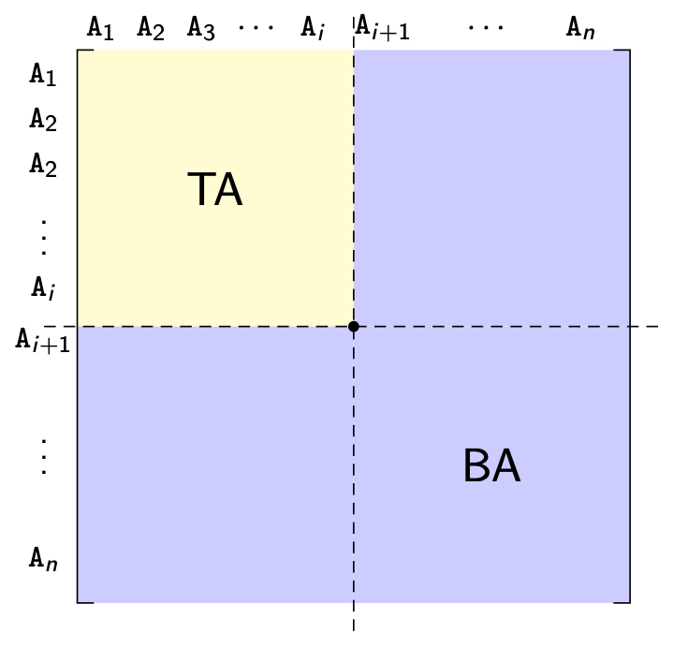
VF – Algorithm
How can you divide a set of clustered attributes {A₁, A₂, …, A_{n}} into two (or more) sets {A₁, A₂, …, A_{i}} and {A_{i}, …, A_{n}} such that there are no (or minimal) applications that access both (or more than one) of the sets.

Slide 43
VF – ALgorithm
Define
TQ = set of applications that access only TA
BQ = set of applications that access only BA
OQ = set of applications that access both TA and BA
and
CTQ = total number of accesses to attributes by applications that access only TA
CBQ = total number of accesses to attributes by applications that access only BA
COQ = total number of accesses to attributes by applications that access both TA and BA
Then find the point along the diagonal that maximizes
CTQ∗CBQ−COQ²

Slide 44
Partitioning
A₁ A₃ A₂ A₄
A₁ 45 45 0 0
45 53 5 3
0 5
0 3
A₁ A₃ A₂ A₄
A₁ 45 45 0 0
45 53 5 3
0 5
0 3
A₁ A₃ A₂ A₄
A₁ 45 45 0 0
45 53 5 3
0 5
0 3
A₃ A₂
A₃ A₂
A₃ A₂
80 75
80 75
80 75
A₄
75 78
A₄
A₄
75 78
75 78
CTQ∗CBQ−COQ² = (45+53+80+45+5) *(78)-(75+3)² = 228*78-78*78 = 11,700
CTQ∗CBQ−COQ² = (45+53+45) *(80+78+75)-(5+3)² = 643*233-64 = 149,755
CTQ∗CBQ−COQ² = (45)*(53+80+78+75+5+3)-(45)² = 45*294-45*45 = 11,205

Slide 45

Partitioning
Bad grouping since A₁ and A₂ are never accessed together
A₄ and A₃ are usually not accessed together
Find the sets of attributes that are accessed, for the most part, by distinct sets of applications.
We look for dividing points along the diagonal such that
Total accesses to only one fragment are maximized, while
Total accesses to more than one fragments are minimized.
A₁ A₃ A₂ A₄
A₁ 45 45 0 0
45 53 5 3
0 5
0 3
A₃ A₂
80 75
A₄ and A₂ are often accessed together
A₄
75 78
Clustered Affinity Matrix (CA)
Cluster 1:
Cluster 2:
A₁ & A₃ A₂ & A₄
Two vertical fragments:
PROJ1(A₁, A₃) and PROJ2(A₂, A₄)

Slide 46
VF – Algorithm
More than two clusters
m-way partitioning
try 1, 2, …, m–1 split points along diagonal and try to find the best point (maximizing Z = CTQ∗CBQ−COQ² ) for each of these
Cost O(2^{m})
Alternative solution
Recursively apply the binary partitioning algorithm to each of the fragments obtained during the previous iteration
Shift a row up and a column left and apply the algorithm to find the “best” partitioning point. Do this for all possible shifts
Cost O(n²), where n = number of attributes

Slide 47
VF – Correctness
A relation R, defined over attribute set A and key K, generates the vertical partitioning F_{R} = {R₁, R₂, …, R_{r}}.
Completeness
The following should be true for A:
A = ∪ A_{Ri}
Reconstruction
Reconstruction can be achieved by
R = ⋈_{K} R_{i}, ∀R_{i} ∈ F_{R}
Disjointness
TID's are not considered to be overlapping since they are maintained by the system
Duplicated keys are not considered to be overlapping

Slide 48

Vertical Clustering—Replication without Fragments
In evaluating the convenience of vertical clustering, it is important that overlapping attributes are not heavily updated.
Example:
EMP(ENUM,NAME,SAL,TAX,MGRNUM,DNUM)
Administrative Applications at Site 1
Applications at all sites
Bad Fragmentation: NAME not available in EMP2
EMP1(ENUM,NAME,TAX,SAL)
EMP2(ENUM,MGRNUM,DNUM)
Good Fragmentation: NAME is relatively stable.
EMP1(ENUM, NAME, TAX, SAL)
EMP2(ENUM, NAME, MGRNUM, DNUM)

Slide 49
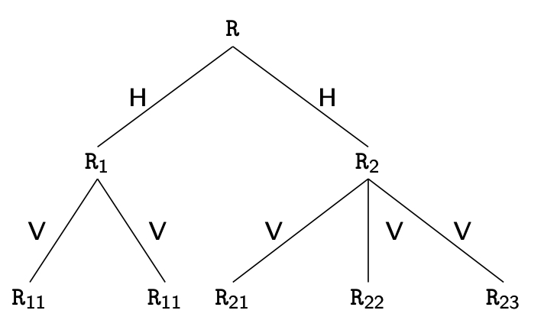
Hybrid Fragmentation

Slide 50

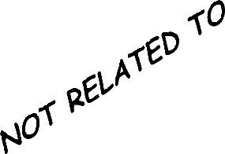








Hybrid Fragmentation
•Apply horizontal fragmentation to vertical fragments.
•Apply vertical fragmentation to horizontal fragments.
Example: Applications about work at each department reference tuples of employees in the departments located around the site with 80% probability.
EMP(ENUM, NAME, SAL, TAX, MGRNUM, DNUM)
ENUM NAME TAX SAL ENUM NAME MGRNUM DNUM
New York
Dallas
Miami
Vertical fragmentation
Horizontal Fragmentation (local work)

Slide 51
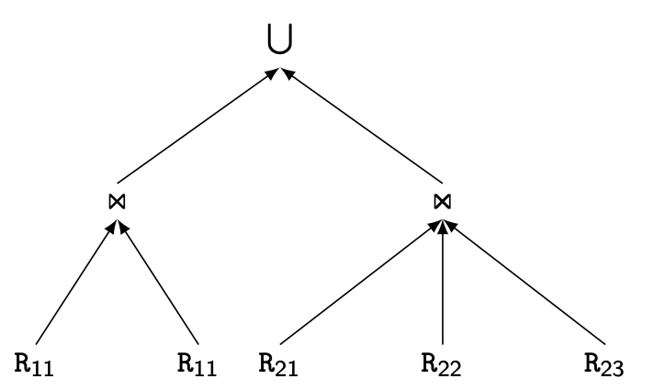
Reconstruction of HF

Slide 52
Outline
Distributed and Parallel Database Design
Fragmentation
Data distribution
Adaptive approaches

Slide 53
Fragment Allocation
Problem Statement
Given
F = {F₁, F₂, …, F_{n}} fragments
S ={S₁, S₂, …, S_{m}} network sites
Q = {q₁, q₂,…, q_{q}} applications
Find the "optimal" distribution of F to S.
Optimality
Minimal cost
Communication + storage + processing (read & update)
Cost in terms of time (usually)
Performance
Response time and/or throughput
Constraints
Per site constraints (storage & processing)

Slide 54
Allocation
File Allocation (FAP) vs Database Allocation (DAP):
Fragments are not individual files
relationships have to be maintained
Access to databases is more complicated
remote file access model not applicable
relationship between allocation and query processing
Cost of integrity enforcement should be considered
Cost of concurrency control should be considered

Slide 55
Allocation Alternatives
Non-replicated
partitioned : each fragment resides at only one site
Replicated
fully replicated : each fragment at each site
partially replicated : each fragment at some of the sites
Rule of thumb:

Slide 56
Allocation – Information Requirements
Database Information
selectivity of fragments (It is the number of tuples of a fragment that need to be accessed to process a query)
size of a fragment
Application Information
number of read accesses of a query to a fragment
number of update accesses of query to a fragment
A matrix indicating which queries updates which fragments
A similar matrix for retrievals
originating site of each query
Site Information
unit cost of storing data at a site
unit cost of processing at a site
Network Information
communication cost/frame between two sites
frame size

Slide 57
Allocation Model
General Form
min(Total Cost)
subject to
response time constraint
storage constraint
processing constraint
Decision Variable
1 if fragment F_{i} is stored at site S_{j}
x_{ij} =
0 otherwise

Slide 58
Allocation Model
Total Cost
Storage Cost (of fragment F_{j} at S_{k})
Query Processing Cost (for one query)
processing component + transmission component
∑
query processing cost +
all queries
∑
∑
cost of storing a fragment at a site
all sites
all fragments
(unit storage cost at S_{k}) ∗ (size of F_{j}) ∗ x_{jk}

Slide 59
Allocation Model
Query Processing Cost
Processing component
access cost + integrity enforcement cost + concurrency control cost
Access cost
Integrity enforcement and concurrency control costs
Can be similarly calculated
∑
∑
(no. of update accesses+ no. of read accesses) ∗
all sites
all fragments
x_{ij} ∗ local processing cost at a site

Slide 60
Allocation Model
Query Processing Cost
Transmission component
cost of processing updates + cost of processing retrievals
Cost of updates
Cost of Retrieval
∑
∑
update message cost +
all sites
all fragments
∑
∑
acknowledgment cost
all sites
all fragments
∑
min
(cost of retrieval command +
all sites
all fragments
cost of sending back the result)

Slide 61
Allocation Model
Constraints
Response Time
execution time of query ≤ max. allowable response time for that query
Storage Constraint (for a site)
Processing constraint (for a site)
∑
storage requirement of a fragment at that site ≤
all fragments
storage capacity at that site
∑
processing load of a query at that site ≤
all queries
processing capacity of that site

Slide 62
Allocation Model
Solution Methods
FAP is NP-complete
DAP also NP-complete
Heuristics based on
single commodity warehouse location (for FAP)
knapsack problem
branch and bound techniques
network flow

Slide 63
Allocation Model
Attempts to reduce the solution space
assume all candidate partitionings known;
select the “best” partitioning
ignore replication at first
sliding window on fragments

Slide 64
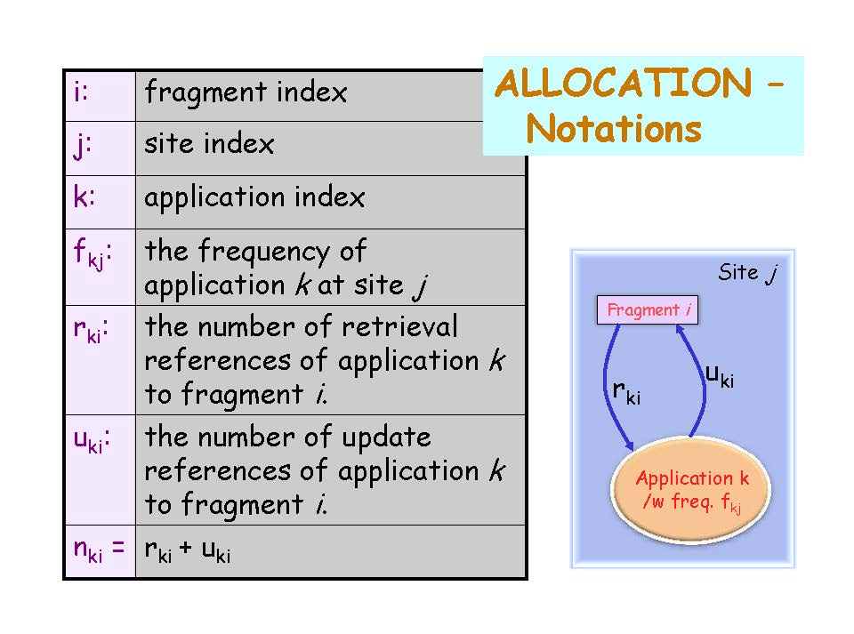

Slide 65
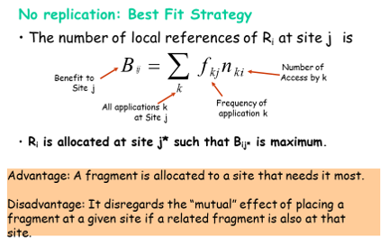
Allocation of Fragments (1)

Slide 66
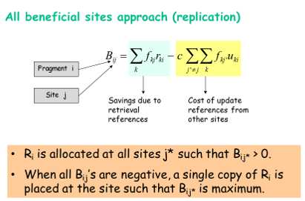
Allocation of Fragments (2)

Slide 67
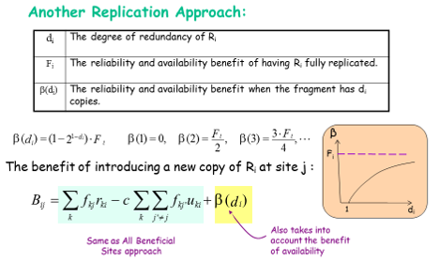
Allocation of Fragments (3)

Slide 68
SUMMARY
Design of a distributed DB consists of four phases:
Phase 1: Global schema design (same as in centralized DB design)
Phase 2: Fragmentation
Horizontal Fragmentation
Primary: Determent a complete and minimal set of predicates
Derived: Use semijoin
Vertical Fragmentation
Identify fragments such that many applications can be executed using just one fragment.
Phase 3: Allocation
The primary goal is to minize the number of remote accesses.
Phase 4: Physical schema design (same as in centralized DB design).

Slide 69
Outline
Distributed and Parallel Database Design
Fragmentation
Data distribution
Adaptive approaches

Slide 70
Adaptive approaches
Redesign as physical (network characteristics, available storage) and logical (workload) changes occur.
Most focus on logical
Three issues:
How to detect workload changes that require changes in the distribution design?
How to determine which data items are going to be affected in the design?
How to perform the changes in an efficient manner?

Slide 71
Detecting workload changes
To be able to detect workload changes, the incoming queries need to be monitored. Periodically analyze system logs, but this may have high overhead
Continuously monitor workload within DBMS
the system monitors the percentage increase in the number of distributed transactions and
considers that the system has changed sufficiently to require a reconfiguration if this percentage increase is above a defined threshold.

Slide 72
Detecting workload changes
One can create a profile that looks at the frequency of each query in a time period, the percentage of queries that meet (or exceed) their agreed-upon latencies.
Then it can be decided whether the changes in the profile require redesign.
The challenge here is to do this efficiently without intruding on the system performance.
This is an open research area that has not been properly studied.

Slide 73
Detecting Affected Items
The next step is to determine what data items are affected and need to be migrated to address this change
How this is done is very much dependent on the detection method. For example, if the system is monitoring the frequency of queries and detects changes, then the queries will identify the data items.
It starts tuple-level monitoring once it detects a system load imbalance.
It collects the “hot” tuples, which are the top-k most frequently accessed tuples within a time period.

Slide 74
Incremental Reconfiguration
The naive approach to perform redesign is to redo the entire data partitioning and distribution. The overhead of redesign is too high to do it from scratch.
The preferred approach is to apply the changes incrementally by migrating data; in other words, we only look at the changed workload and the data items that are affected, and move them around.

Slide 75
Incremental Reconfiguration
One obvious approach is to use an incremental graph partitioning algorithm that reacts to changes in the graph representation.
Once the set of hot tuples are identified, a migration plan is prepared that identifies where the hot tuples should be moved and what reallocation of cold tuples is necessary.
Another approach is database cracking, which is an adaptive indexing technique that targets dynamic, hard to predict workloads.
In adaptive indexing, indexes are built continuously with every query. Each query runs several operators and each operator performs incremental physical changes that improve the structure of indexes.

Slide 76

Assignment #1

